Slide 1
Rebuilding Quality The AWE Next Generation Quality Professional 8th March 2024 Prof Amanda McKay CQP FCQI

Slide 2
Overview
Amanda McKay
Why do we need to re-build quality?
The Quality Professional today
The Quality Professional of the Future
How do we get there? what needs to change.
AWE a Case Study
Summary
Questions

Slide 3
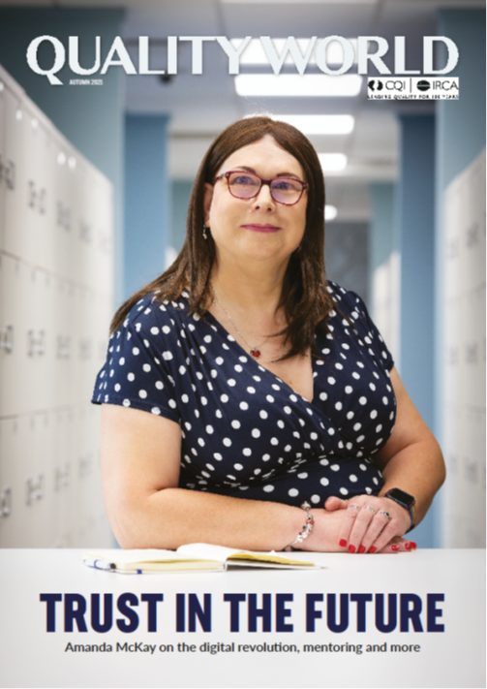
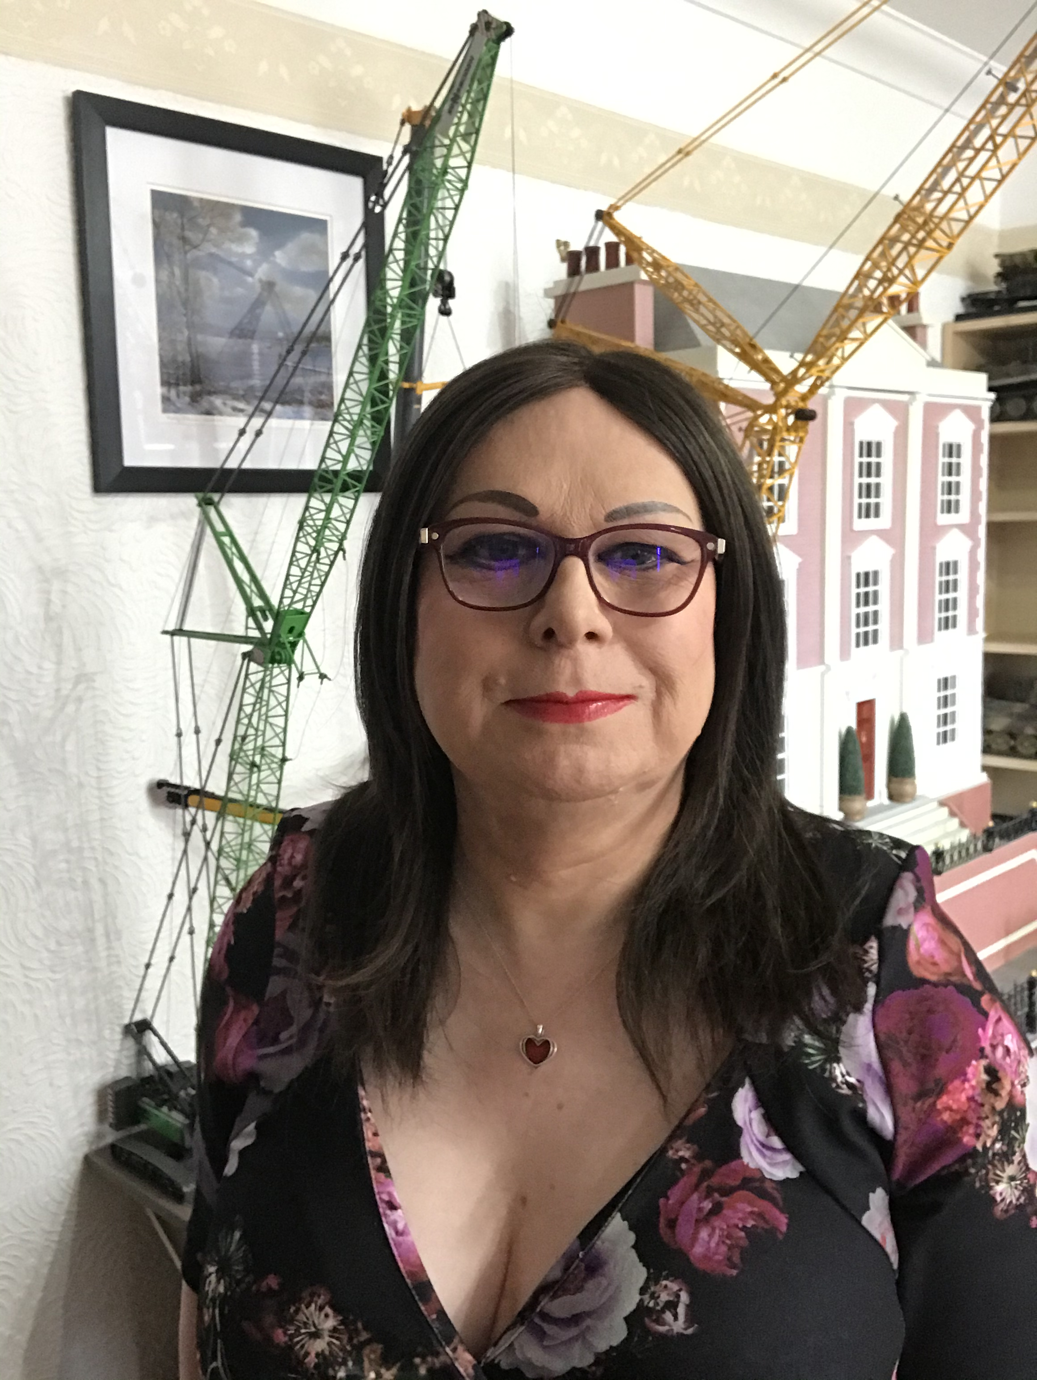
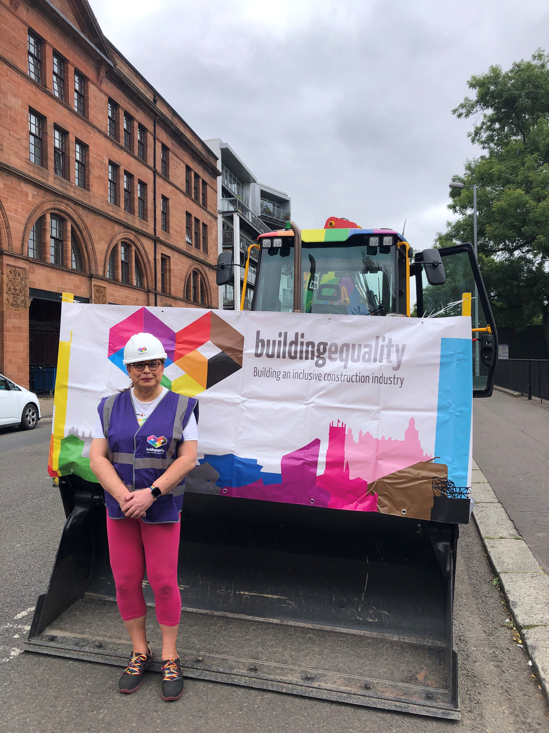
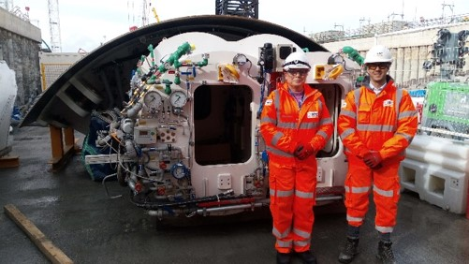
Amanda McKay & AWE
Quality professional with over 35 years experience in Oil & Gas, Nuclear, Construction and Defence sectors.
Chair of the Chartered Quality Institute.
Director of Quality at the Atomic Weapons establishment.
Honorary Professor of UWS
Lifelong volunteer :-
UK Military
Policing
LGBTQ+ Rights
Women in Nuclear
Coaching, mentoring and counselling

Slide 4
Context
Whilst the issues discussed here are universal to the Quality profession in the UK, the discussion will be mainly in relation to the UK Civil and Defence Nuclear sectors.
The UK Nuclear sector is currently suffering from a skills shortage and Quality is one of the key shortfall areas.
Within Nuclear, Quality is the foundation of effective Nuclear Safety and without Suitably Qualified and Experience Quality professionals we cannot operate.

Slide 5
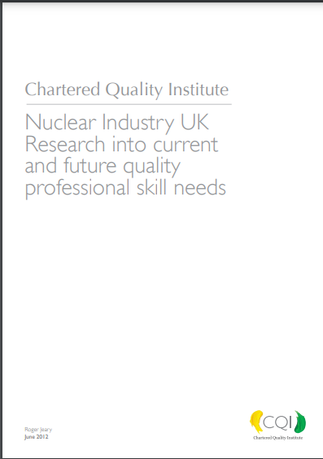
Why do we need to re-build quality?
The profession has an aging demographic
Nuclear identified a Quality skills problem in 2006.
Quality seen as a second career option.
Nuclear renaissance has increased the demand for quality professionals, and the need for an expanded skill set.
The skill set we need today is far more extensive than that of yesterday.

Slide 6
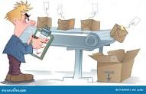
The Quality Professional today
Quality not always seen as a first career.
The profession is sometimes seen as inspection/QC focused.
There is no obvious entry route to Quality as a career.
There is no ‘Licence to Operate’ as in some other professions, there is no requirement for professional qualifications and memberships to practice in quality.
Sometimes seen as traditional and not innovative, not familiar with digital and too constrained by inspection and audit as a toolkit.

Slide 7
The Quality Professional of the Future
The Nuclear sector has debated the future quality requirements for several years but they do not differ from many other sectors, there needs to a be a key focus in the following areas:-
Core Quality focus on assurance, Governance, Improvement & Leadership.
Greater skills and experience in front end engineering design and specification to develop right first time approaches and engineer out problems.
More focus on Quality Assurance and less on inspection/QC.
Skills in Project Management and understanding the role of Quality in Projects.

Slide 8
The Quality Professional of the Future
Fully versed in the Digital approach to Quality and all that Quality 4.0 can bring to an organisation.
A practitioner with a full toolkit for problem solving and improvement and a capability to deliver collaborative work and coach others in this area.
The Quality Practitioner and function need to be fully integrated into the organisation and be an advocate for excellence, seen as an essential part of every team.
We will still need some of the traditional skills in quality, QC and Inspection won’t go away, neither will metrology. The Quality professional of the future will be a multi-skilled practitioner ale to lead and guide the business towards excellence.

Slide 9
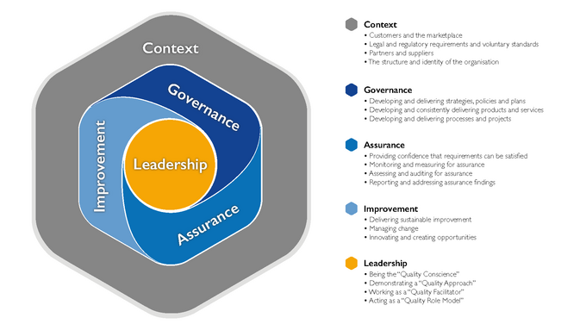
How do we get there? what needs to change?
The Quality profession needs a make over! A re-brand to show the depth and breadth of what we do, the variety of roles and types of work we are involved in.
We need a ‘Licence to Operate’ to ensure we have competent people.
We need to develop entry routes to Quality as a first career, this will include apprenticeships, trainee schemes, and first degree qualification routes.
Adopting of the CQI competence framework for Quality professionals and career maps to define the progression routes ensuring that we develop Quality leadership capabilities, not just practitioners
Focus our efforts on assurance and prevention with the value add of improvement, rather than simply checking.

Slide 10
AWE a Case Study
Started to re-position the Quality Profession with AWE, active promotion of careers in Quality and a move away from QC to QA. Create a Future Quality Team.
We have a full time Head of Profession to help our strategy, to identify the skills and career paths for Quality in the future.
Created our own Competence framework and career paths, aligned to the profession map from CQI, ensured that leadership and soft skills are part of the development path.
Implemented a resourcing strategy for AWE Quality backed by a communications plan linked to our candidate engagement plan, actively seeking people a more diverse set of candidates..
Created new entry routes to AWE Quality from graduates to apprentices and direct entry.
Created closer links to academia and higher education, more engagement with younger people through schools and STEM.

Slide 11
AWE a Case Study
Built quality into every project and transformation activity to ensure it is embedded from ‘Gate 0’ and has a seat at the Exec and Board.
Created closer links to academia and higher education, more engagement with younger people through schools and STEM, great emphasis on research and new techniques..
Built a capability around Digital and Quality 4.0, not easy in a Nuclear Defence establishment. Built digital real time performance reporting and measuerement to improve evidence lead decision making.
Created our own next generation Quality group to support mentoring and knowledge transfer as well as career support, and a Quality Community of Practice group supporting the organisation.
Encourage and support active participation in CQI SIGs and Branches.
We are a CQI ATP delivering training to all staff in AWE.

Slide 12
Summary
The Nuclear sector and particularly AWE recognised a need for change in the skills set and capabilities of the quality professional.
To move from a re-active QC focused approach to a proactive, assurance and improvement focus.
The age profile and demographic of the Nuclear Quality practitioner community dictated a new and bold approach to re-building the community and raising the profile of Quality in the sector.
The AWE approach, whilst not yet complete, will see new direct entrants to Quality, a focus on training from scratch and extensive use of apprenticeships and graduate schemes to build capacity.
Our approach will build an agile, competent Quality practitioner, with skills in digital, assurance, improvement and collaborative working able to lead projects and be solution focused.

Slide 13
Questions?

