Slide 2
Breaking the 80/20 rule
Tally Singer Executive Director, Membership & Commercial Services tsinger@quality.org

Slide 3
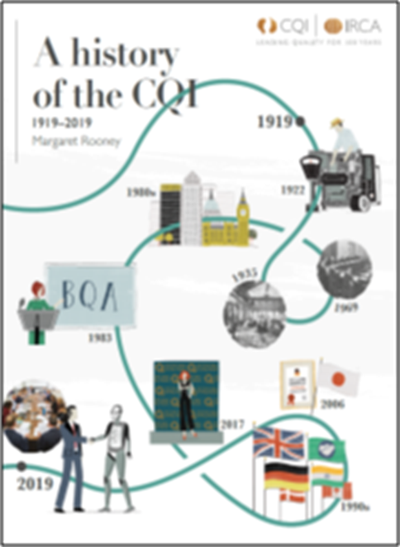
The CQI
Our Mission
To promote quality management for the benefit of society.
Our Vision
A world in which organisations of all types and sizes thrive by providing outstanding value for customers, stakeholders and society.
Our Activities
- Promotion and advocacy
Research and collaboration
Development and recognition

Slide 4
80/20 rule
INPUT
OUTPUT

Slide 5
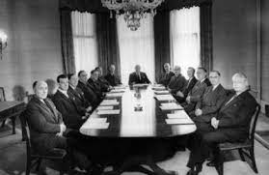
Where we were…

Slide 6
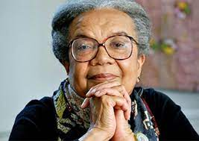
“You can’t be what you can’t see.”
Marian Wright Edelman
(Founder of Children’s Defense Fund)

Slide 7
What has the CQI done?
Actively addressed our Board of Trustee diversity
Published an EDI policy, appointed a champion within the executive
Using more inclusive imagery in our marketing
Encouraged events to start at different times
Tested the new profession map with 450 professionals from different backgrounds, nationalities and genders
It is not a ‘project’ to be ticked off – it is part of our DNA

Slide 8
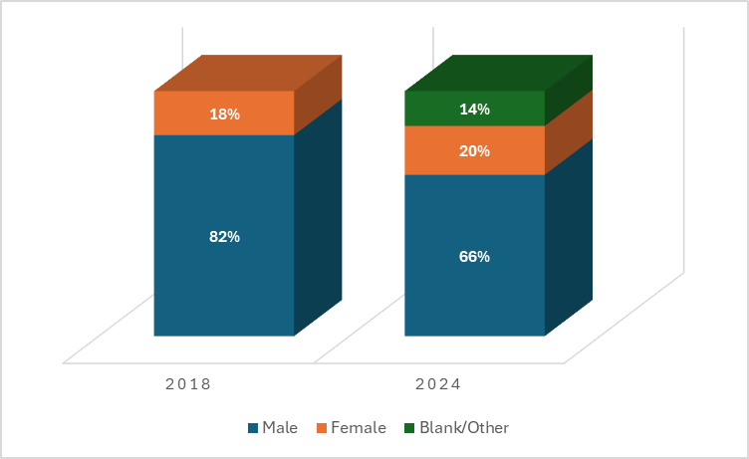
Progress – CQI membership

Slide 9
Progress – gender by age

Slide 10
Progress – gender pay gap
Shirley Parsons – UK quality salary and workforce insights report, 2024

Slide 11
“Diversity is being invited to the party; inclusion is being asked to dance.”
Verna Myers (Vice President of Inclusion Strategy at Netflix)

Slide 12
The case for change
The % of new entrants joining the profession with a quality specific qualification
CQI – Workforce Insights, 2021/22

Slide 13
The % of respondents with plans to seek promotion as a quality or QMS audit professional
CQI – Workforce Insights, 2021/22

Slide 14
There is more to do
How valued by their employer do quality and audit professionals feel by their employer?
CQI – Workforce Insights, 2021/22

Slide 15
91% of quality directors are male
Shirley Parsons – UK quality salary and workforce insights report, 2024

Slide 16
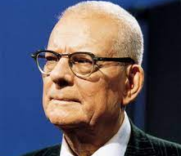
“The greatest waste in America is failure to use the abilities of people”
Deming, W. Edwards. (2000). Out of the Crisis – 2nd Edition. Kindle Edition. The MIT Press.

