Slide 1
Menopause in the Workplace
Dr Clair Crockett
8th March 2024

Slide 2
Overview
What is the menopause?
Who does the menopause affect?
What symptoms can be experienced?
How can menopause impact the workplace?
What can be done to help?

Slide 3
What is the menopause?

Slide 4
Meno – pause
Menstruation – stops
Menopause average age 51 years
Perimenopause
Early menopause = <45years
Premature ovarian insufficiency = <40yrs
Surgical or medically induced menopause

Slide 5
Who does the menopause affect?

Slide 6
Women of all ages
Women of all ethnicities
LGBT+ community
Men and children
Everyone!

Slide 7
What symptoms can be experienced?

Slide 8
Physical symptoms of menopause
Hot flushes / night sweats
Poor sleep
Fatigue
Altered menstrual cycle
Joint and muscle pains
Headaches
Worsening migraine
Dizziness
Tinnitus
Palpitations
Weight gain
Change in body shape
Dry skin
Itching
Thinning hair
Dry eyes
Urinary symptoms
Recurrent UTI
Vaginal dryness
Notes:
Cardiologist
Rheumatologist
Ophthalmologist
ENT
Dermatologist

Slide 9
Psychological symptoms of the menopause
Anxiety
Low mood
Paranoia
Loss of motivation and interest
Irritability
Anger
Poor concentration and memory
Low confidence and low self esteem
Suicidal thoughts

Slide 10
How can menopause impact the workplace?

Slide 11
Midlife is when women are often at peak of careers - but crippling symptoms and lack of support is hampering careers.
99% said symptoms had a negative impact on their careers.
59% had taken time off work due to their symptoms: 18% were off more than eight weeks.
Reasons for taking time off included reduced efficiency (45%), poor quality of work (26%) and poor concentration (7%).

Slide 12
Lack of menopause awareness and support is costing the UK economy £10 billion.
Counting cost of staff leaving, and recruitment costs for rehiring and training replacement staff.
Women face up to a £30,000 pension shortfall.

Slide 13
What can be done to help?

Slide 14
Change culture and remove taboos (menopause guidance, support groups, talks)​.
Provide menopause education for all​.
Empower with evidence-based medical resources and tools to help women make informed choice about their health and treatment options.

Slide 15
For line managers
Understand the impact of hormone changes.
Advocate for your staff: help remove barriers that may prevent a colleague from thriving at work​.
Signpost to evidence-based ​​resources and support available ​​in your organisation​.
Notes:
Menopause symptoms can be considered a disability and employers face being sued if they do not make "reasonable adjustments", a watchdog has said.
The Equality and Human Rights Commission (EHRC) issued the guidance to clarify the legal obligations to workers going through the menopause.
The EHRC said bosses should offer changes such as providing rest areas or flexible hours to help.
Relaxing uniform policies to allow women to wear cooler clothes could also help.
Failing to make "reasonable adjustments" amounts to disability discrimination under the Equality Act 2010 if the symptoms have a "long-term and substantial impact" on a woman's ability to carry out their usual day-to-day activities, the EHRC said.
The EHRC adds that taking disciplinary action against women for a menopause related-absence could amount to discrimination, and that language that ridicules someone's symptoms could constitute harassment.

Slide 16
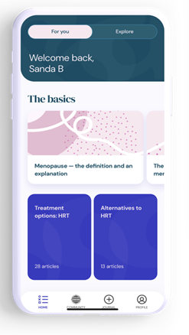
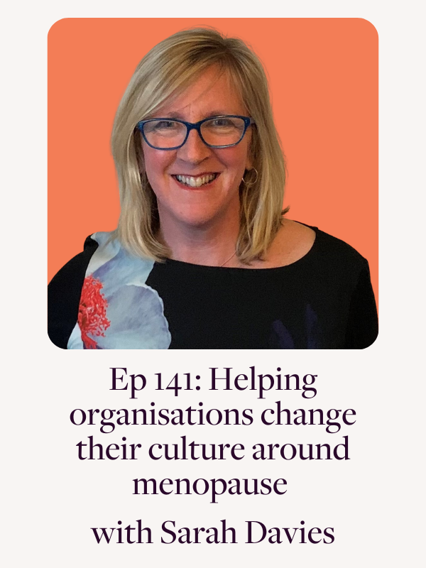
For you
balance app and website
medically approved features
track symptoms
hear other women’s experiences
Listen to Dr Louise Newson podcast – expert guests and real-life stories
Read The Definitive Guide to the Perimenopause & Menopause

Slide 17
Thank you for listening!
Want to know more?

